Slide 1
GENE THERAPY
EKOTT, NYIKKEABASI BASSEY
GROUP ONE 5TH COURSE
KHARKOV NATIONAL MEDICAL UNIVERSITY

Slide 2
Gene therapy is a technique which is used to treat genetic diseases, that involves replacing an absent gene in the DNA of a patient.
Gene therapy became more feasible after the human genome project.

Slide 3
Severe Combined Immune Deficiency (ADA-SCID)
Hemophilia
Chronic Granulomatous Disorder (CGD)
Though this technology is less than two decades, it has already been applied to treat patients. There is still room for development in the future.

Slide 4
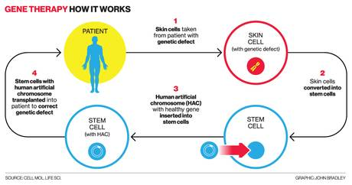
Gene therapy works by inserting an absent gene into the genome of the patient and then producing more copies of the gene.

Slide 5
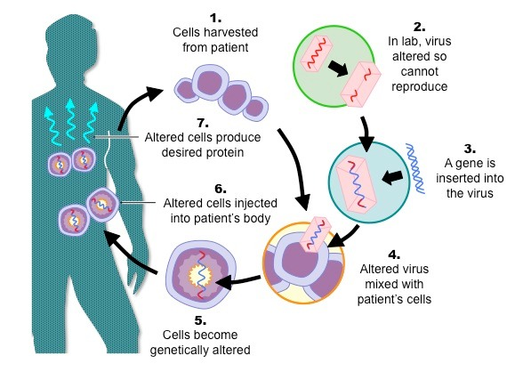
It is possible to use a retrovirus to deliver a gene to the DNA of the person –Think Lysogenic Infection

Slide 6
The Challenges of Gene Therapy:
Cost
Negative Publicity
Immunological Rejection (like in Hemophilia)
Disruption of Important Genes (Gamma C gene and Leukemia)
Depending on how fast science can circumvent the drawbacks associated with gene therapy, it might be possible for physicians to offer gene therapy from their offices.

